Slide 1
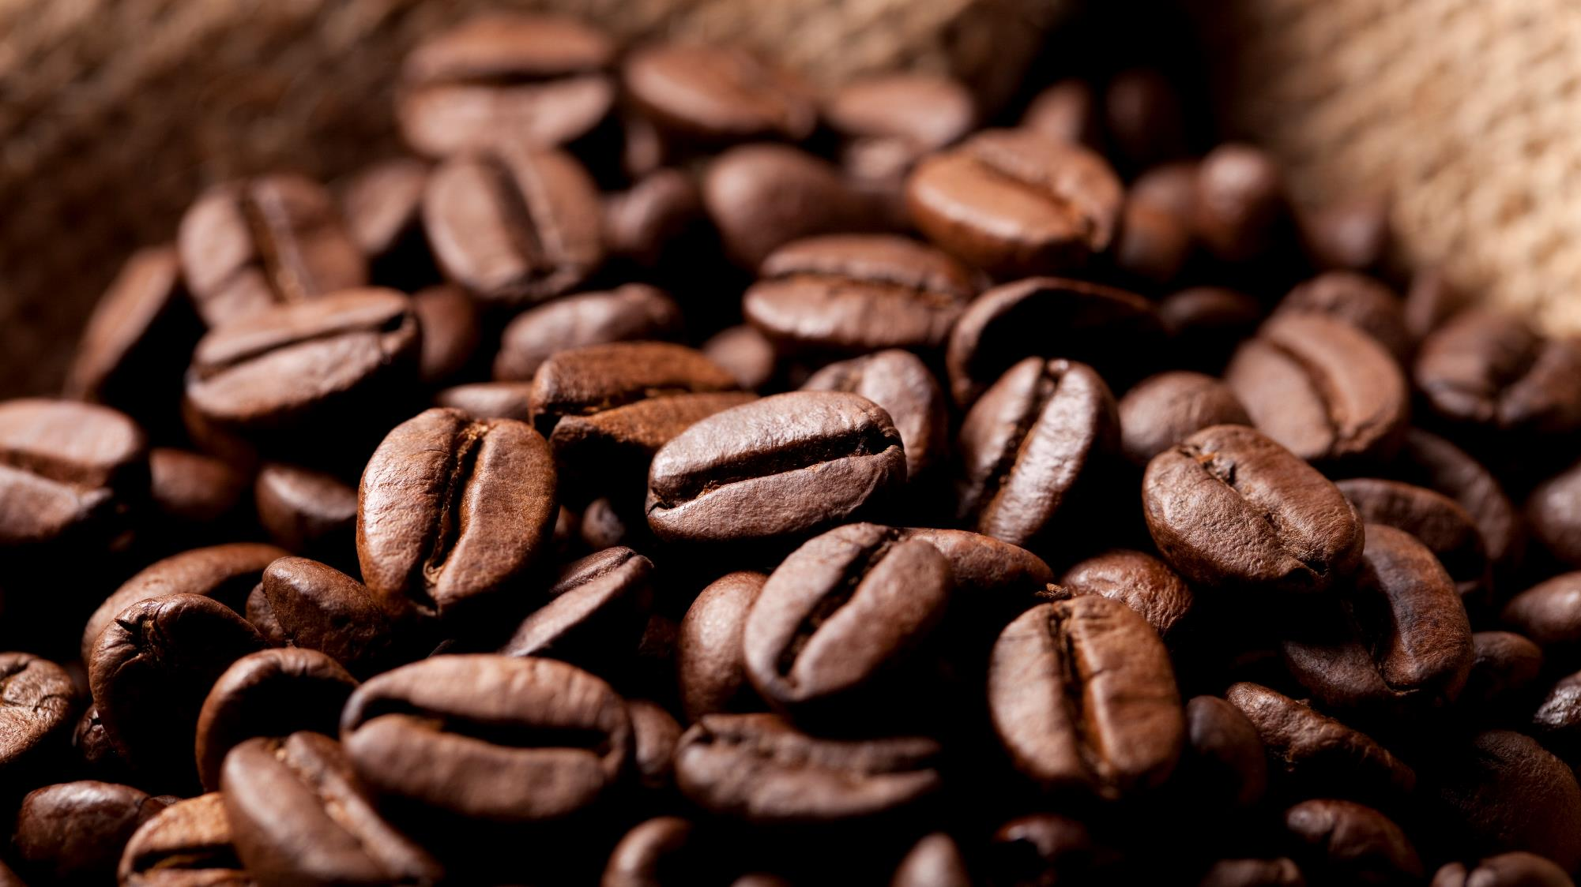
The Third wave transformation in coffee market
By Illy Café

Slide 2

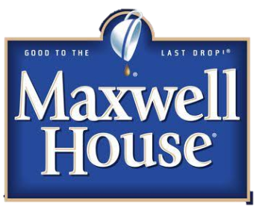
Third wave?
2nd Wave: Quality and Higher Prices
3rd Wave: Premium Coffee as an Art by it’s expertise.
1st Wave: Coffee a Mass Commodity

Slide 3






Current coffee shop considered bad by coffee purists?
While some coffee shop been famous for their coffee but some said they haven’t served any great coffee.
Notes:
Reference:
https://www.quora.com/Why-is-Starbucks-considered-bad-by-coffee-purists-Why-do-people-hate-sneer-at-Starbucks

Slide 4
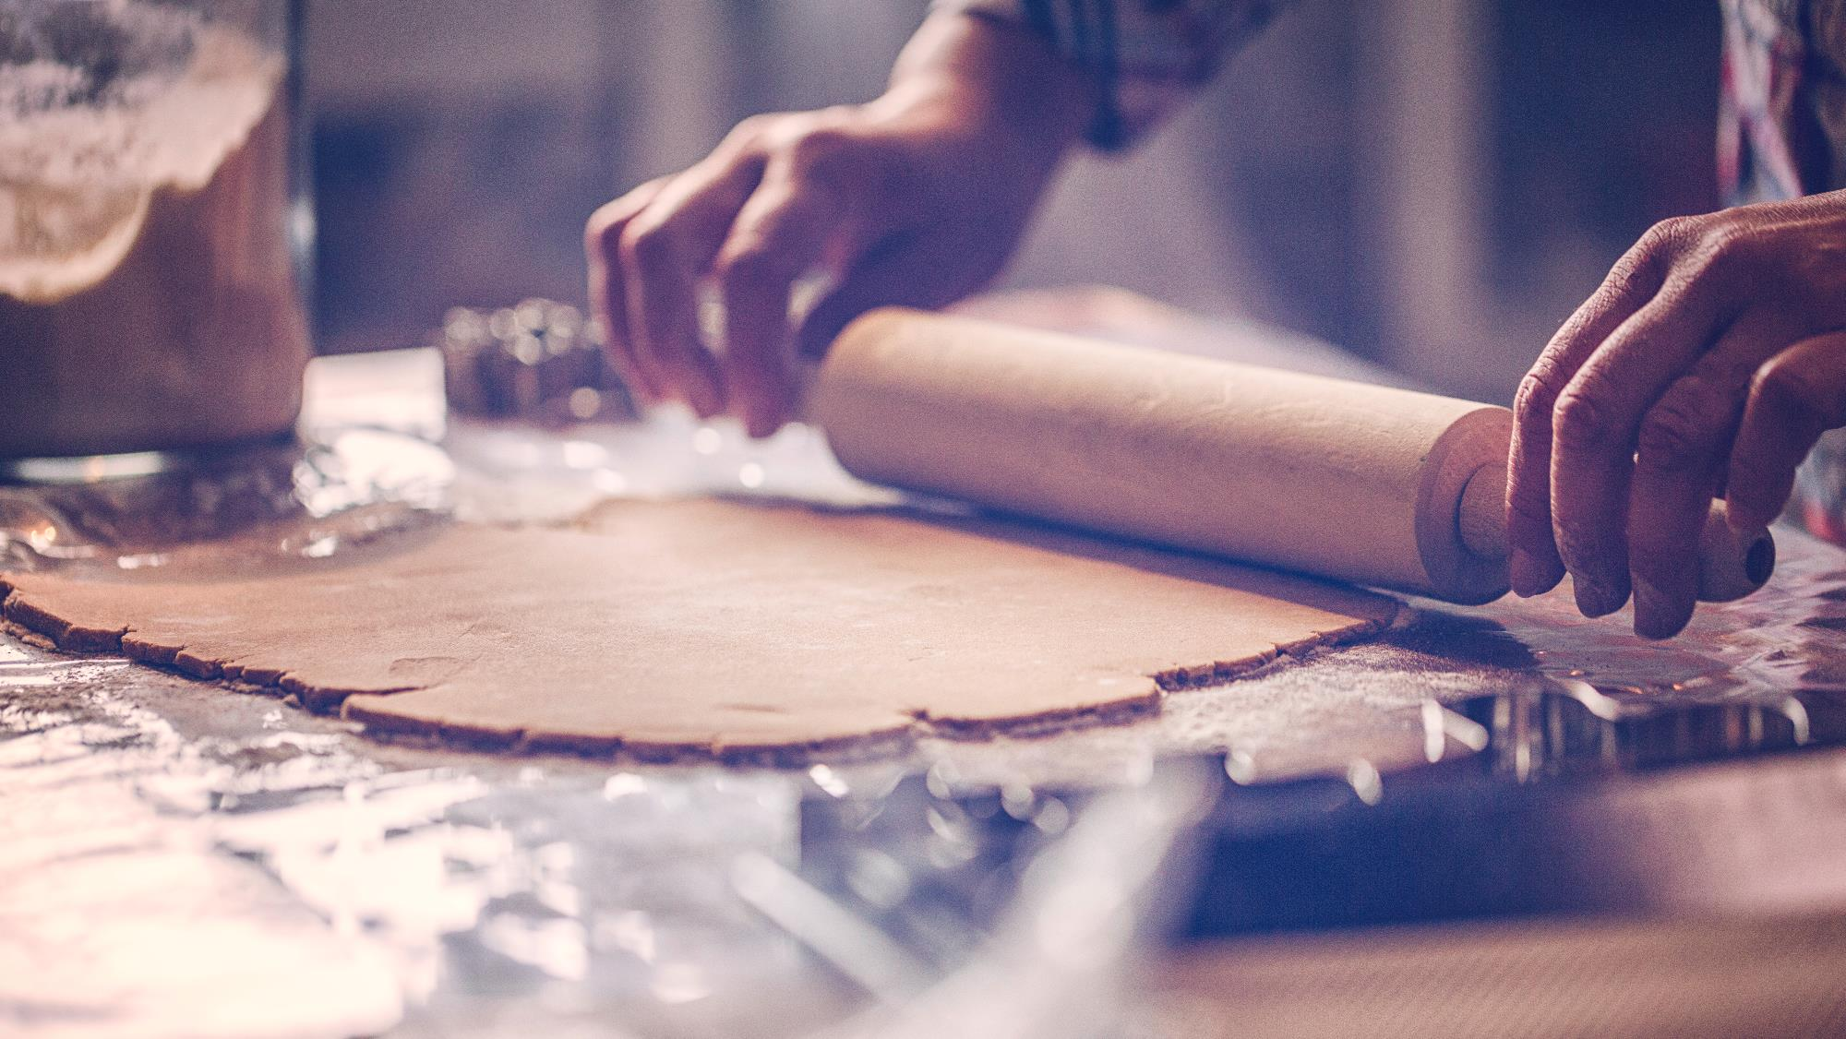

Key of success
Better Taste
Equitable Process
Innovation
Better Service
Educated Stakeholder

Slide 5
Improvement on Business component
Research and Development this component is crucial, since it was where the ideas/innovations came from. Basically this function would try to find any process, product that will revolutionize coffee company in the future.
Delivery since one of the goal is to educate every stakeholders(farmers, roasters, baristas, customer) about coffee making process(growing, roasting, grinding, brewing, etc.), this function will had an assignment on how to educate them.
Marketing apart from delivering the product, marketing team will also have a big assignment to plan how company values digested by public, what’s being offered, etc.

Slide 6
Company Transformation
Apart from improvement on each business components listed on previous slide, there might be great idea to transform company’s process:
Digitalization process, delivery through mobile apps.
Data driven decisions through analysis of historical transactions or market research.

Slide 7
Proposed ideas
Mobile application for transaction process (delivery, digital payment, KYC)
Since climate change has been a big factor of crop failure, we proposed to setup some IoT to farmer’s crops(know what variables that might reduce crop failure and grow good crop)

Slide 8

Thank You

